Slide 1

Algorithm Analysis IT-2101 Lecture - 8
Dr. Mohammad Abu Yousuf
yousuf@juniv.edu

Slide 2
Dynamic Programming -2

Slide 3
Computing a binomial coefficient by DP

Slide 4
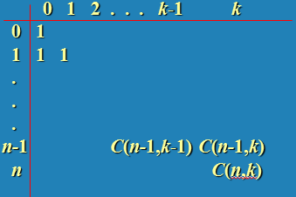
Computing a binomial coefficient by DP
Binomial coefficients are coefficients of the binomial formula:
(a + b)^{n} = C(n,0)a^{n}b⁰ + . . . + C(n,k)a^{n-k}b^{k} + . . . + C(n,n)a⁰b^{n}
Recurrence: C(n,k) = C(n-1,k) + C(n-1,k-1) for n > k > 0
C(n,0) = 1, C(n,n) = 1 for n ≥ 0
Value of C(n,k) can be computed by filling a table:

Slide 5
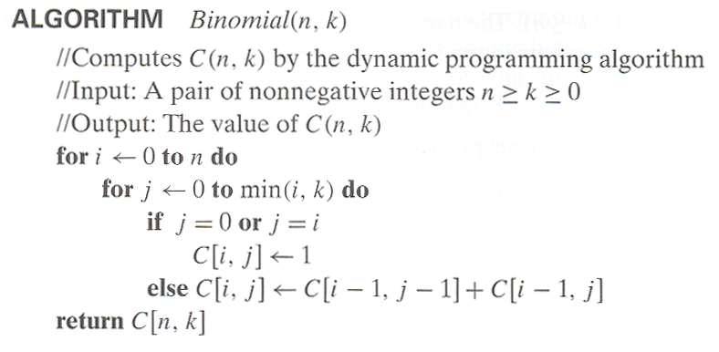
Computing a binomial coefficient by DP
Time efficiency: Θ(nk)
Space efficiency: Θ(nk)

Slide 6
Longest Common Subsequence (LCS)

Slide 7
LCS
A subsequence of a sequence/string S is obtained by deleting zero or more symbols from S. For example, the following are some subsequences of “president”: pred, sdn, predent. In other words, the letters of a subsequence of S appear in order in S, but they are not required to be consecutive.
The longest common subsequence problem is to find a maximum length common subsequence between two sequences.

Slide 8

LCS
For instance,
Sequence 1: president
Sequence 2: providence
Its LCS is priden.

Slide 9

LCS
Another example:
Sequence 1: algorithm
Sequence 2: alignment
One of its LCS is algm.

Slide 10
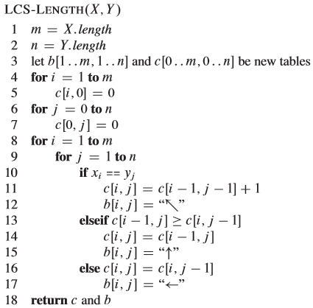
LCS

Slide 11
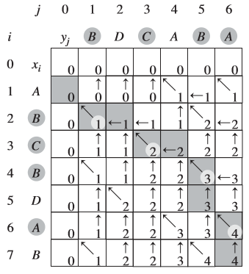
LCS
Figure shows the tables produced by LCS-LENGTH on the sequences X = {A, B, C, B, D, A, B} and Y = {B, D, C, A, B, A}.

Slide 12
LCS

Slide 13
Running time
The running time of the procedure is O(mn), since each table entry takes O(1) time to compute.

Slide 14
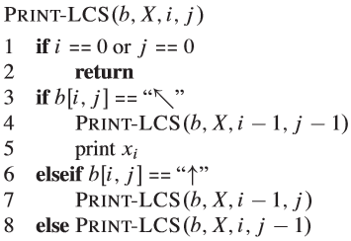
LCS
The initial call is PRINT-LCS (b, X, X.length, Y.length).
For the b table in Figure, this procedure prints BCBA. The procedure takes time O(m+n), since it decrements at least one of i and j in each recursive call.

Slide 15
Thank you

